Slide 1
Mini Project
LOAN APPLICATION STATUS PREDICTION
Created By:-
Eklavya Yaadav
AI/ML Intern

Slide 2
INTRODUCTION
Loan approval is a critical decision-making process for financial institutions. Approving loans to applicants with a high probability of default can lead to significant financial losses. On the other hand, rejecting applicants who are likely to repay can lead to lost business opportunities. Therefore, the ability to predict loan approval outcomes based on an applicant's profile can help optimize lending processes, reduce financial risk, and improve customer satisfaction by speeding up the decision-making process.

Slide 3
OBJECTIVE
The goal of this project is to develop a predictive model that can accurately determine whether a loan application will be approved based on the applicant's profile. This prediction model can be invaluable for financial institutions, helping them to assess the risk associated with lending to different applicants more efficiently.

Slide 4
Methodology
Approach - We utilize machine learning models to analyze the dataset and build predictive models. The focus is on understanding how different factors influence the likelihood of loan approval
Models Used - We applied Logistic Regression, Random Forest, K - Neighbors Classifier, and Decision Tree Classifiers to make predictions.

Slide 5
Dataset overview
Features: Loan_ID, Gender, Married, Dependents, Education, Self_Employed, ApplicantIncome, CoapplicantIncome, LoanAmount, Loan_Amount_Term, Credit_History, Property_Area.
Target Variable: Loan_Status (Approved/Not Approved).
Dataset Size: Dataset includes 614 Rows and 13 Columns

Slide 6
TECHNOLOGY USED
Programming Language:
Python: The primary language used for data manipulation, model building, and evaluation.
Libraries:
Pandas: For data loading, preprocessing, and manipulation.
Scikit-learn: Used for model building, training, evaluation, and hyperparameter tuning.
Matplotlib & Seaborn: Employed for data visualization, providing insights into the data distribution and feature relationships.
Development Environment:
Jupyter Notebook: It is the original web application for creating and sharing computational documents.

Slide 7
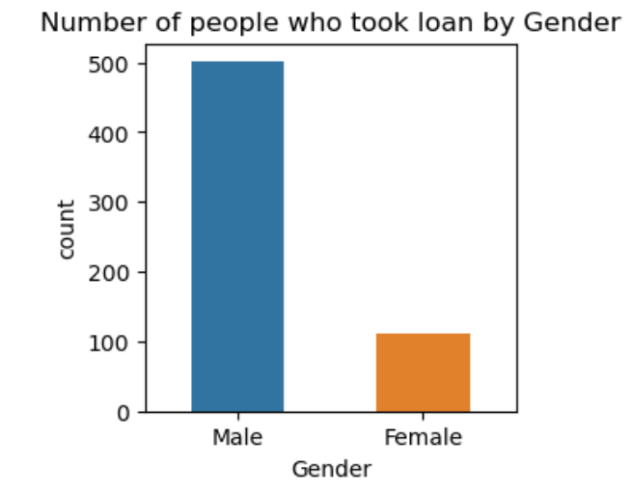
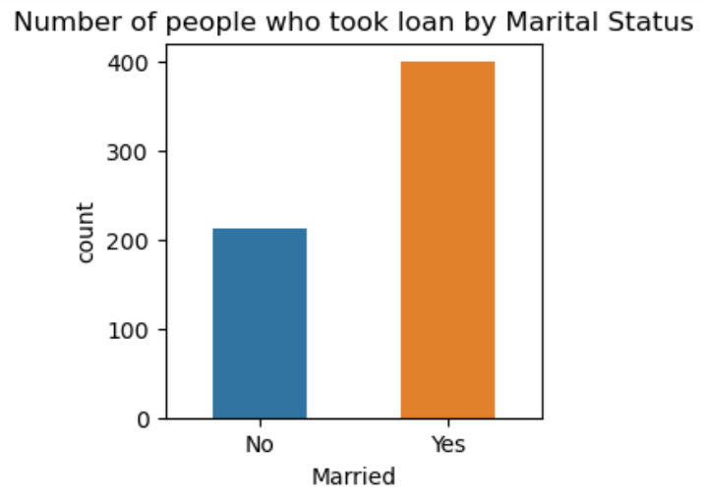
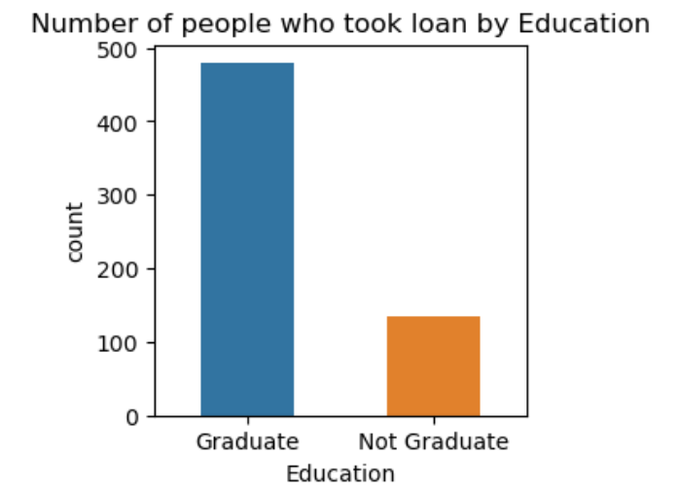
Data visualization

Slide 8
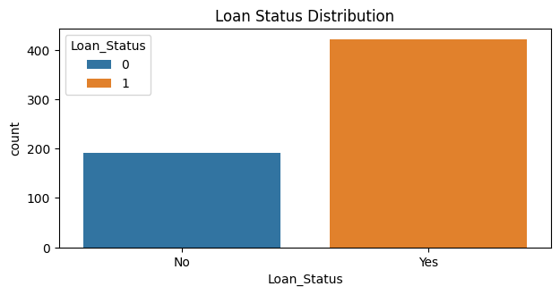
Overall loan distribution

Slide 9
Data preprocessing
Handling Missing Values:
Categorical columns (e.g., Gender, Married) were filled with the mode (most frequent value).
Numerical columns (e.g., LoanAmount, Loan_Amount_Term) were filled with the mode and median to handle missing data.
Encoding Categorical Variables:
Label Encoding was applied to convert categorical features like Gender, Married, Education, and Property_Area into numerical form.
Feature Engineering:
Created a new feature TotalIncome by combining Applicant Income and Coapplicant Income to better represent the financial capacity of the applicant.
Feature Scaling:
Applied StandardScaler to normalize features such as loan Amount and Total Income, ensuring all features are on a similar scale. Dataset Split:
The dataset was divided into training (75%) and testing (25%) sets to evaluate model performance on unseen data.

Slide 10
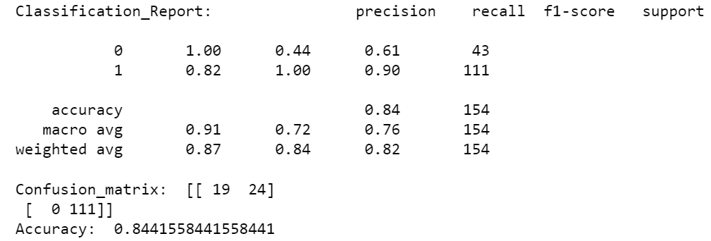
Model training and evaluation
  Logistic Regression:
    Accuracy: Achieved 84% accuracy.
    Confusion Matrix: Showed a strong ability to differentiate between approved and non-approved loans.

Slide 11
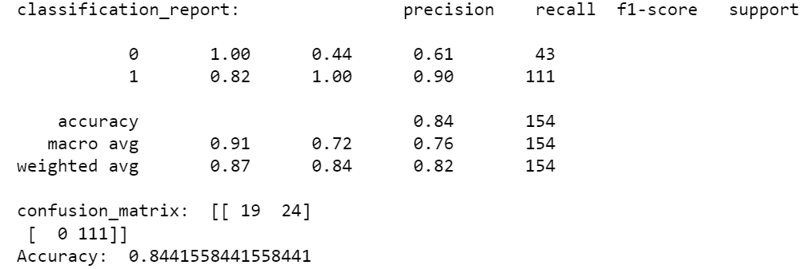
  Random Forest:
    Accuracy: Achieved 84% accuracy.
    Confusion Matrix: Some misclassification, particularly with borderline cases.

Slide 12
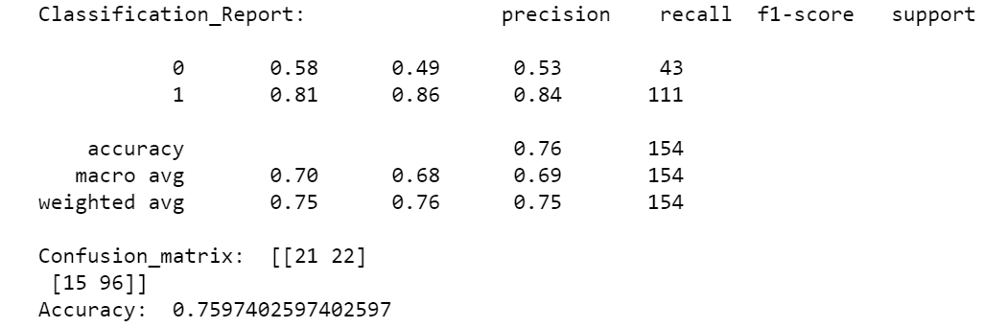
  Decision Tree:
    Accuracy: Achieved 75% accuracy.
    Confusion Matrix: Showed more misclassification errors compared to other models.

Slide 13
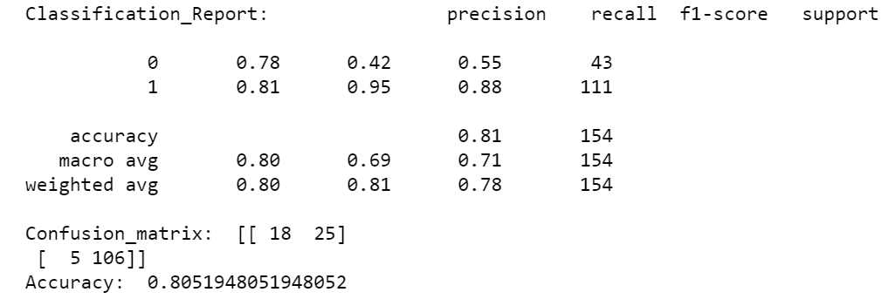
K Neighbour Classifier
    Accuracy: Achieved 80% accuracy.

Slide 14
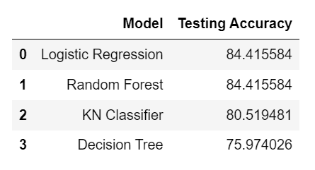
Result comparison
Model Comparison: Accuracy, Precision, Recall for all Four models.
Best Model: Logistic Regression and Random Forest with 84.41% accuracy.
Conclusion: Logistic Regression and Random Forest is the most reliable model for predicting loan approval.

Slide 15
conclusion
This project highlights the importance of preprocessing, model selection, and evaluation in achieving accurate predictions.
Logistic Regression and Random Forest are recommended as the best model for loan approval prediction due to their consistent performance across all metrics.

Slide 16
Thank you

